Slide 1
Neural Supersampling for real-time rendering SIGGRAPH 2020 CS482 – Interactive Computer Graphics
YUAN QIAODI
Department of Mechanical Engineering
Korea Advanced Institute of Science and Technology

Slide 2
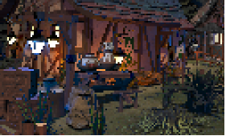
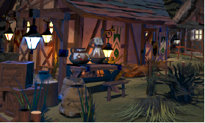
Introduction
Display resolutions and demands for photorealistic visual quality is increasing
e.g. virtual reality headsets: 2880x1600 pixels at 90-144Hz, recent gaming monitor: 3840x2160 pixels at 144Hz[1]
upsampling
Low resolution result
high resolution result
[1] Lei Xiao, Salah Nouri, Matt Chapman, Alexander Fix, Douglas Lanman, and Anton Kaplanyan. 2020. Neural supersampling for real-time rendering. ACM Trans. Graph. 39, 4, Article 142 (July 2020), 12 pages.

Slide 3
Challenge
Image/video supperresolution
Suppersampling for real-time rendering
Pixel area integral
Point sample
Both antialiasing and interpolation problem
[1] Lei Xiao, Salah Nouri, Matt Chapman, Alexander Fix, Douglas Lanman, and Anton Kaplanyan. 2020. Neural supersampling for real-time rendering. ACM Trans. Graph. 39, 4, Article 142 (July 2020), 12 pages.

Slide 4
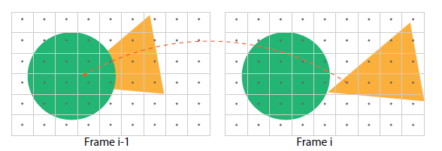
Problem setting
Input images with point-sampled pixels are aliased at shading and edges
Information at the target to-be-interpolated pixels is missing
what
Low resolution
high resolution
This paper wants to use color, depth, motion vectors in different frames to address problems
pros: provides candidate matching between pixels for low cost
cons:
Pixels at a previous frame cannot be directly project to current frame
Dynamic occlusions
Partial optical flow, not consider changes in lighting, reflectance
[1] Lei Xiao, Salah Nouri, Matt Chapman, Alexander Fix, Douglas Lanman, and Anton Kaplanyan. 2020. Neural supersampling for real-time rendering. ACM Trans. Graph. 39, 4, Article 142 (July 2020), 12 pages.

Slide 5
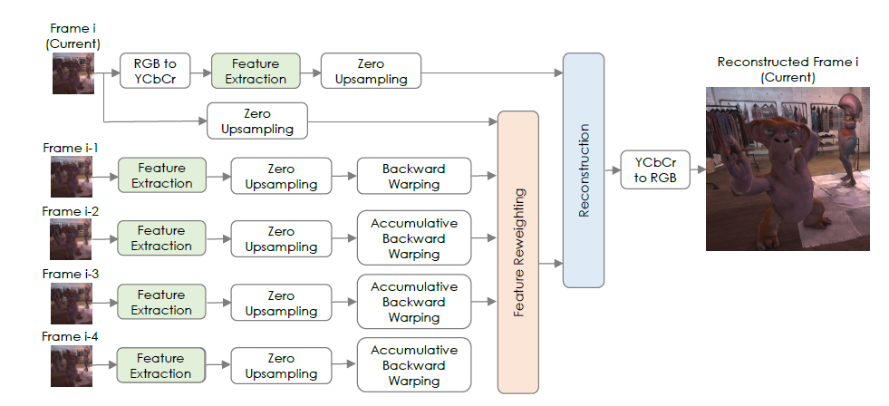
Network Overview
Dynamic occlusions and shading changes
Temporal Reprojection

Slide 6
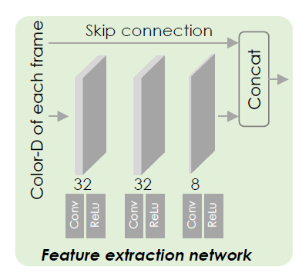
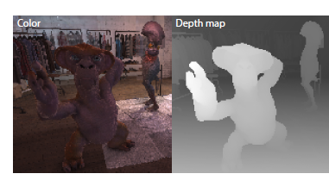
Feature extraction
input
Output
8 feature channel + color + depth

Slide 7
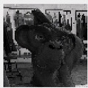
Temporal reprojection
Project pixel samples and learned features of previous frame to current frame
12 channels
One channel feature map
Project to frame i
Zero upsampling
Frame i-1
Low resolution Motion vectors map
bilinear upsampling
high resolution Motion vectors map

Slide 8
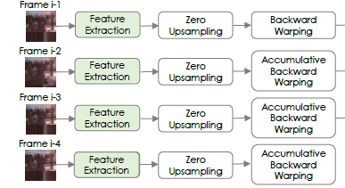
Temporal reprojection
Up to 4 previous frames are projected to current frame
Motion vector is defined for an adjacent pair of frames
Reprojection to current frame

Slide 9
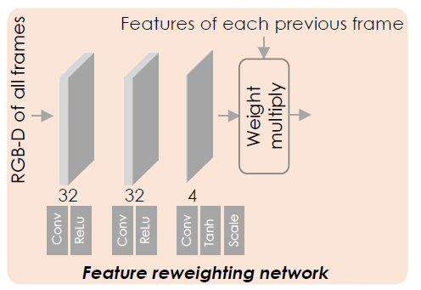
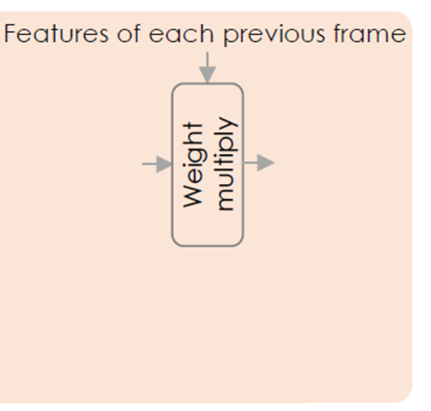
Feature reweighting
Motion vectors do not reflect dynamic occlusions and shading changes
Feature reweighting module to mask out mismatched samples
A Pixel-wise weighting map for previous frames

Slide 10
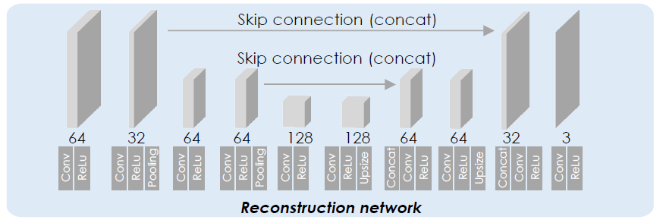
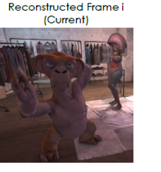
Reconstruction
Unet[1]
Feature of current frame + reweighted features of previous frame
[1] Ronneberger O., Fischer P., Brox T. (2015) U-Net: Convolutional Networks for Biomedical Image Segmentation. In: Navab N., Hornegger J., Wells W., Frangi A. (eds) Medical Image Computing and Computer-Assisted Intervention – MICCAI 2015. MICCAI 2015. Lecture Notes in Computer Science, vol 9351. Springer

Slide 11
Loss
Perceptual loss from a pretrained VGG-16 network[2]
x: network output, $\overline{x}$:reference high resolution image
Aim: measure perceptual and semantic differences between images
Luminance
pre-trained image classification network have already learned to encode the perceptual and semantic information
SSIM: structural similarity index [1]
contrast
structure
w=0.1
[1] Zhou Wang, A. C. Bovik, H. R. Sheikh and E. P. Simoncelli, "Image quality assessment: from error visibility to structural similarity," in IEEE Transactions on Image Processing, vol. 13, no. 4, pp. 600-612, April 2004
[2] Johnson J., Alahi A., Fei-Fei L. (2016) Perceptual Losses for Real-Time Style Transfer and Super-Resolution. In: Leibe B., Matas J., Sebe N., Welling M. (eds) Computer Vision – ECCV 2016. ECCV 2016. Lecture Notes in Computer Science, vol 9906. Springer
Notes:
human visual perception is highly adapted for extracting structural information from a scene

Slide 12
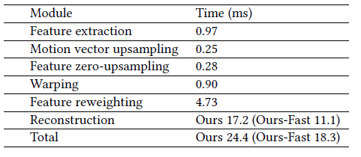
Result
Time efficiency:
Our-Fast: Unet output channel (except final ) of each layer reduced by 50%
Break down of each module

Slide 13
Result
[1] Bee Lim, Sanghyun Son, Heewon Kim, Seungjun Nah, and Kyoung Mu Lee. 2017. Enhanced deep residual networks for single image super-resolution. In Proceedings
of the IEEE Conference on Computer Vision and Pattern Recognition Workshops. 136–144.
[2] https://dl.acm.org/doi/abs/10.1145/3386569.3392376

Slide 14
Limitations
Generalization: gracefully degrade in quality outside of the trained domain
Failed in multi-frame inputs contain too little information (extreme aliasing)

